Slide 1

Beacon Health
July 15, 2014
Michael Donahue, VP of Network Development & ACO Activities
Iyad Sabbagh, MD
Senior Medical Director, ACO Activities

Slide 3
Beacon Health by the Numbers
22,000 Medicare Patients
12,000 EMHS employees and their families
13,000 Friends & neighbors
1,100 MaineCare Patients
Negotiations underway to grow our population another 60,000

Slide 4
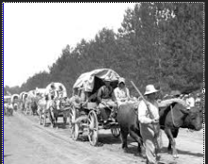
Why Pioneer?

Slide 5
Building a Statewide Network

Slide 6
Population Health
Multidisciplinary team: Patient representative, Physicians, Care Coordinators, Quality Nurses, Home Health, CCT, SNF, Pharmacy, hospital and practice administrators, IT, project management, wellness coordinators.

Slide 7
Sub teams and work groups
Pharmacy
Adherence
Brand/Generic
Injectable
Clinical Standards
Prevention Standards
Chronic Disease Standards
Specialty Standards

Slide 8
Post Acute Care
Quality and utilization dashboard
SNF 3-Night waiver (screening, monitoring and
transition management)
Home health and hospice management
Care Management
Complex care coordination
Disease management
Transition of care management.

Slide 9
Utilization Review
Lab Utilization Review
  High frequency lab utilization
  High cost lab utilization
  Cost of lab
  Clinical protocol
  Outpatient
  Inpatient
Quality Review Committee

Slide 10
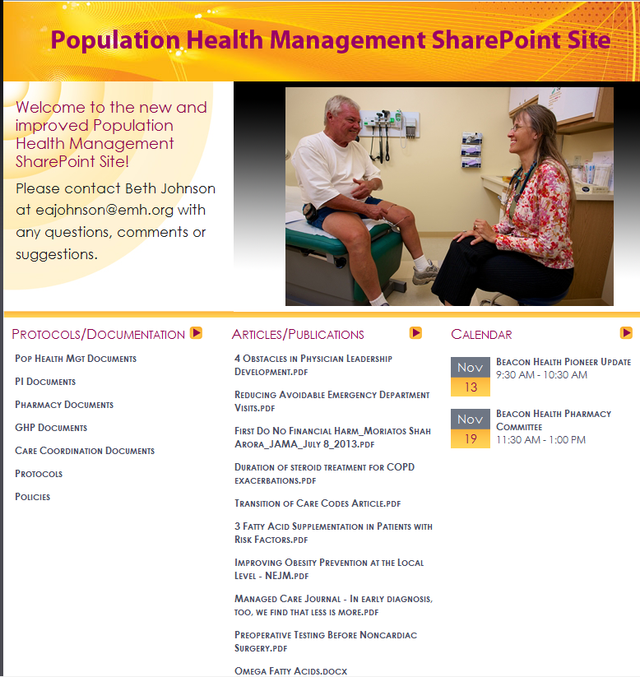
How are we sharing best practices?

Slide 11
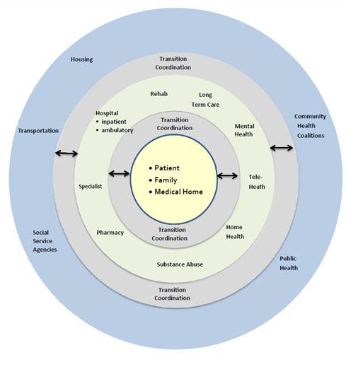
Community-Based Care Model
Notes:
System Leadership Conference—Fall 2010
7/8/2014 12:13:55 PM
11

Slide 12
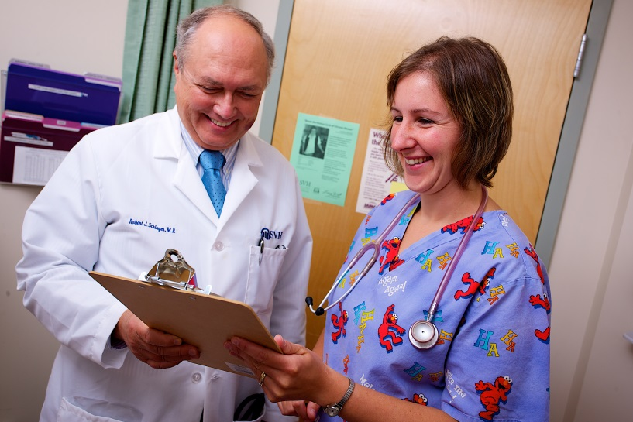
PCP Team Based Care
Practice redesign to ensure team based care.
Goal to become provider of health and wellness to the community
Ensure ALL staff work toward new population health goals

Slide 13

Population Health is a mind set
The more I do, the better I am.
One patient at a time, please.
I provide excellent care-how do I know? Because I think so!
When I see a patient, I’ll set the agenda.
Come back several times a year, whether you need it or not.
That is how I am going to do it because that’s how I was trained.
“I hate cookbook medicine”!!
Only primary care providers have to worry about ACO’s-they don’t really affect me.
I still may have to do a lot, but let it be based on value.
I have to think of my entire patient panel.
The care I give is measured and compared to the care provided by others.
Patients and consumers of health now set the agenda.
Please come back when either you or I realize a need.
I will do things based on best practices and protocols.
“I love protocols”-I don’t forget things or make errors as much as in the past.
We’re all in this together!

Slide 14
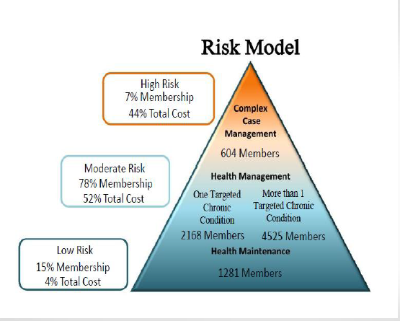
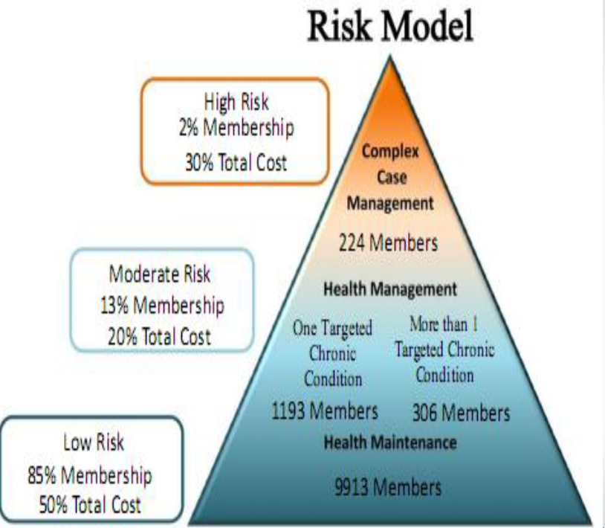
Population segmentation
EMHS Pioneer

Slide 15

The Journey…..

Slide 16
Beacon Health Care Coordination Program

Slide 18
The Care coordination journey
UR
Case management
Disease management
Chronic care management
Care coordination
1980 1990 2000 2010

Slide 19

Nurse Care Coordinators
Chronic Disease
Complex Patients
Education
Embedded
Community Resources
Collaborative

Slide 20
Functions of Care Coordinator
Transitions of care
High-risk chronic disease management
Exacerbation management
Self management
Telephonic and/or device monitoring
Frequent follow up

Slide 21
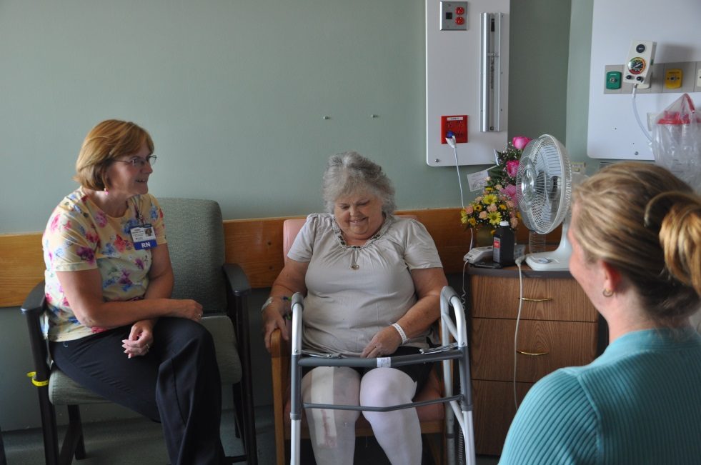
Transitions of Care Coordinators – Coordinating at Points of Care

Slide 22

Pioneer Patients Feel the Difference
Hospital Readmissions down 13%
Nurse care coordination follow-up with 91% of patients
Patient satisfaction with provider 93%

Slide 23
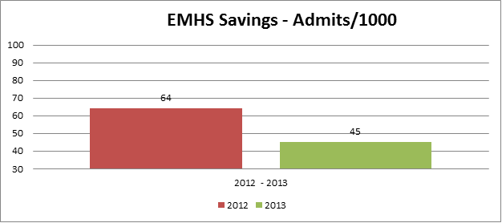
EMHS Employees Feel the Difference

Slide 24
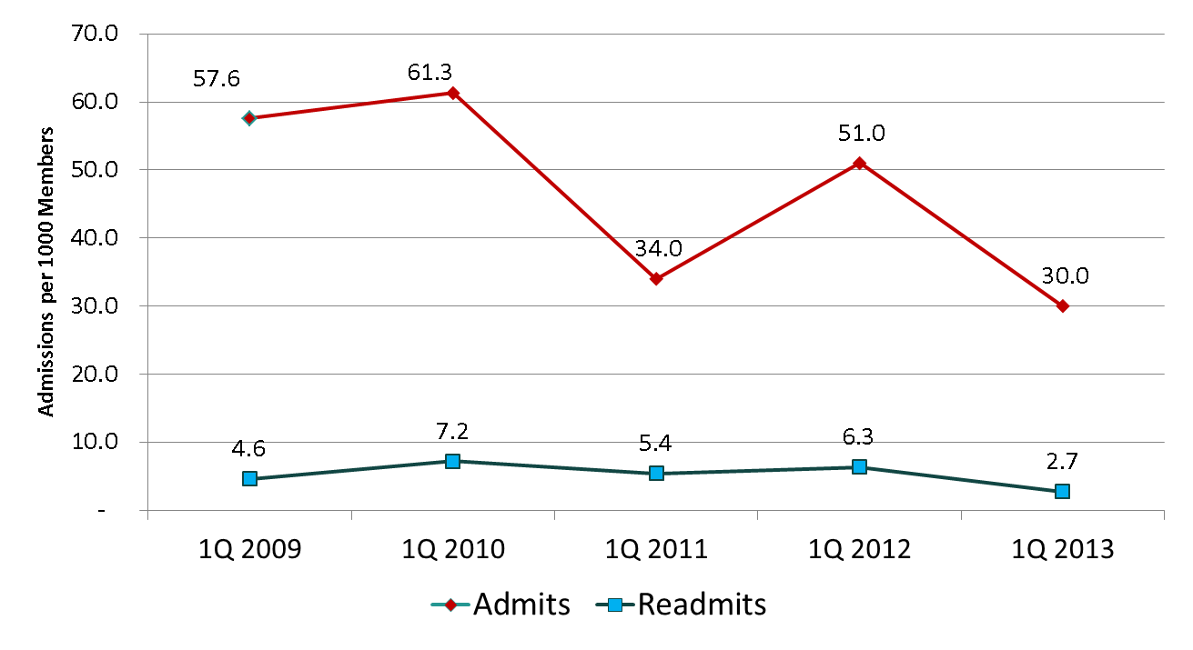
Medical Surgical Admissions have decreased 40%
Readmissions have decreased 57%

Slide 26
Lesson Learned
Technology: EMR and Claims data.
Practice readiness: PCMH involvement.
Care Coordination: Lack of standardization.

Slide 27

Questions?

